Slide 1


Beneficial Use of Fly Ash for Concrete Construction in California
B. Stein, R. Ryan, L. Vitkus, J. Halverson
WOCA 2015

Slide 2
Use of Class F fly ash is vital to the development of concrete construction in California. Historically the demand for it has been driven by:
The hot and dry climate of many counties necessitating better control of workability
The aggressive environment of some coastal and desert areas (due to the presence of chlorides) necessitating the reduction of permeability of concrete
Vast lands contaminated with sulfates necessitating the enhancement of sulfate-resistance of concrete
The reactivity with alkali of many siliceous aggregate deposits necessitating mitigation of deleterious expansion
Overview

Slide 3
The demand for fly ash between 2015 and 2020 may double driven by:
Growing concrete consumption
State greenhouse gas legislation
Limited availability of other SCM
Governing concrete construction specifications requiring (i) the extension of service life, (ii) the reduction of consumption of non-renewable resources, and (iii) the reduction of embodied energy
Rapidly developing construction of tall buildings, high-speed rail, sophisticated bridges, water conveying and retaining structures, all requiring high-performance concrete
Growing mass concrete construction necessitating both the reduction of heat generation and mitigation of heat induced delayed ettringite formation
Overview

Slide 4
The relative average replacement rate of Portland cement with SCM is forecasted to increase from ~ 10% in 2014 to ~ 20% plus in 2020, mainly due to:
Relative increase of consumption of concrete containing 20-30% of fly ash Class F by the total weight of cementitious material in the total volume of concrete produced with fly ash
Increase in volumes of consumption of concrete containing 35-50% of binary SCM consisting of fly ash and ground granulated blast furnace slag
Increase of the replacement rate of Portland cement with fly ash Class F in mass concrete (for such structures as foundations and dams) to 40-50%
Inception of SCM produced from California mined pozzolans
Overview

Slide 5
When proportioning concrete and selecting the replacement rate of Portland cement with SCM, suppliers and contractors typically consider:
Constructability
Performance and prescriptive requirements of governing project technical specifications and standards
Quality of construction
Durability and service life
Environmental aspects, among them carbon footprint and embodied energy
Initial and life cycle costs
Possible stimulus credits in recognition of value added by fly ash and/or other SCM
Some specific effects of fly ash, which most typically are considered when concrete is proportioned for constructability and performance, are provided on the following slide.
Analysis of State-of-Practice

Slide 6
Property/Characteristic/Attribute | Typical Effects of an Increase in Substitution Rate of Portland Cement with Fly Ash Class F
Water requirement | Decreases
Workability [formability, pumpability] | Improves, stabilizes at mid-replacement rates
Setting time | Extends, especially at lower temperatures
Ability to transfer hydraulic pressure | Prolongs (fresh concrete)
Bleeding | Reduces
Heat of hydration | Reduces
Potential for DEF | Reduces; max temperature limit may be relaxed
Air entrainment and air-void system | May increase the demand in air-entraining agent, may impact stability of the air-void system
Strength | Slows early age strength gain Enhances strength gain within time
Permeability | Reduces
Expansion due to alkali-silica reaction | Reduces
Sulfate resistance | Improves
Resistance to carbonation | Decreases
Analysis of State-of-Practice

Slide 7


Wilshire Grand Replacement Hotel Downtown Los Angeles, Mat Foundation
Concrete Production and Construction Challenges
Continuous placement - 16208 m³ (21,200 yd³)
Time restrictions – 18.5-hour placement
Congested city block and construction site
Limited delivery routes
Hourly placement rate ~ 880 m³ (1,150 yd³)
Multiple batch plants – delivery, placement, QC
Depth of mat 17.5-foot - thermal control
Case Studies, 2014

Slide 8

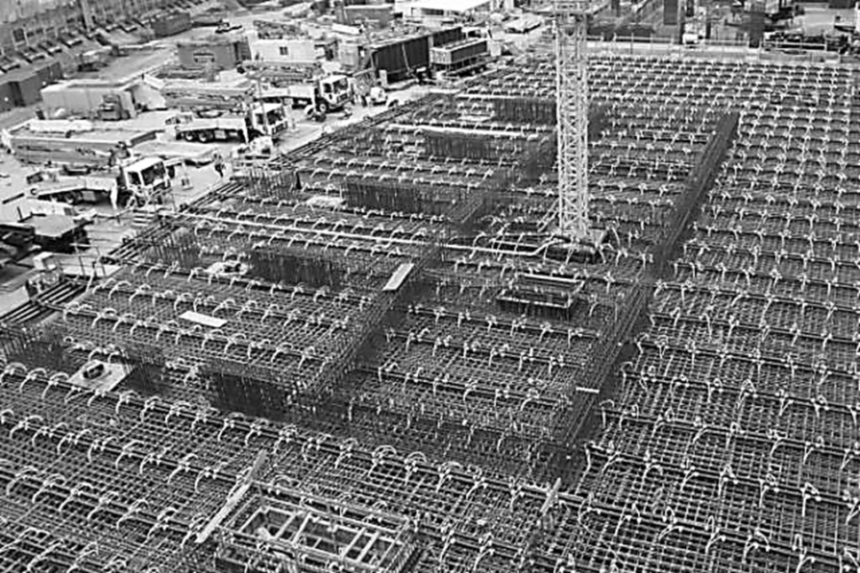
Facts
8 batch plants (two ready mix companies)
Fleet of ready mix trucks – 263 units
Cement and fly ash - 107 delivered trains
Aggregates - 193 delivered truck units
Concrete - 2,120 delivered loads
13 street level pumps, 2 pit level pumps
Thermal control – cooling pipes, insulation
13 concrete sampling and curing stations
168 sets of cylinders for control of strength
More than 1,000 concrete test cylinders
Concrete mix
90-day f’c 41.4 MPa (6,000 psi)
25-mm (1”) MSA siliceous aggregate
Portland cement IIMH/V, 25% Fly ash Class F
W/CM=0.40, mid-range water reducer
Construction Schedule
Time restrictions were met
Concrete performance
Maximum t was within allowed 71°C (160°F)
Maximum ∆t was within acceptable
All test sets met specified strength
Case Studies, 2014
Wilshire Grand Replacement Hotel Downtown Los Angeles, Mat Foundation

Slide 9
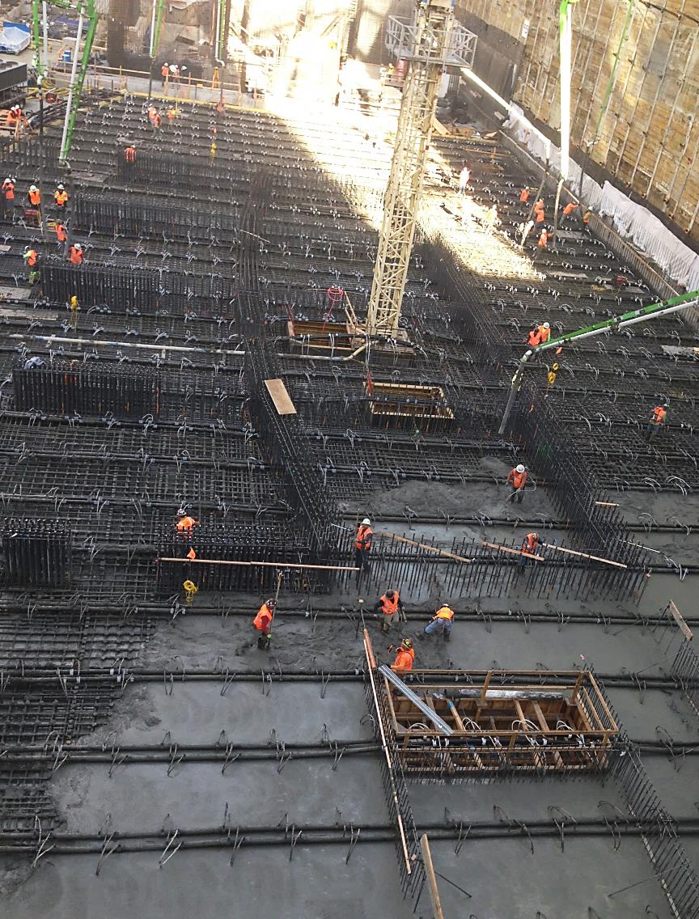

Evaluated Data (all batch plants) | Results
Number of test sets | 168
Minimum strength, MPa (psi) | 45.6 (6615)
Maximum strength, MPa (psi) | 58.3 (8460)
Average strength, MPa (psi) | 50.6 (7340)
Batch-to-batch STDEV, MPa (psi) | 2.10 (305)
Coefficient of variation, % | 4.2
Case Studies, 2014
Wilshire Grand Replacement Hotel Downtown Los Angeles, Mat Foundation

Slide 10
Concrete used for airfield paving was proportioned as follows:
Specified MOR 4.5 MPa (650 psi), required MOR 5 MPa (725 psi)
Maximum slump for slip-forming - 38 mm (1.5 inch)
W/CM satisfying required MOR was established based on laboratory relationship “MOR Vs W/CM”
Air content 3% (to enhance formability)
Cementitious blend Portland cement II/V & fly ash Class F (25%)
Aggregates – siliceous, maximum size 25-mm (1-inch), continuously graded, optimized coarseness and workability factors
Chemical admixtures – normal range water reducer and air-entraining agent
Case Studies, 2010
San Diego International Airport, Airfield Paving

Slide 11
Content of fly ash was selected for satisfying the following constructability and performance considerations:
Mitigation of expansion due to reaction between siliceous aggregates and alkali (mortar-bar method)
Uniformity of development of MOR in early and final specifications ages
Minimization of plastic shrinkage cracking and cracking of hardened concrete in early age
Concrete performance
Concrete demonstrated high uniformity of strength (one contributing factor was the uniformity of chemical and mineral composition of fly ash)
Average MOR closely matched the design requirement
Proper construction practices accounting for the effect of the fly ash allowed for controlling cracking
Case Studies, 2010
San Diego International Airport, Airfield Paving

Slide 12
Evaluation of MOR Data | Age, days
 | 3 | 7 | 14 | 28
Number of test sets | 64 | 170 | 200 | 263
Minimum MOR, MPa (psi) | 3.1 (455) | 3.4 (495) | 3.4 (490) | 4.2 (610)
Maximum MOR, MPa (psi) | 4.5 (645) | 5.1 (740) | 5.5 (795) | 6.2 (900)
Average MOR, MPa (psi) | 3.8 (551) | 4.2 (611) | 4.6 (664) | 5.0 (727)
Standard deviation, MPa (psi) | 0.28 (41) | 0.30 (44) | 0.32 (47) | 0.35 (51)
Coefficient of variation, % | 7 | 7 | 7 | 7
Case Studies, 2010
San Diego International Airport, Airfield Paving

Slide 13
The efficiency of the substitution of Portland cement with the specific fly ash source is enhanced when concrete proportions and construction practice are mutually optimized, as provided in Bullets 1 and 2 on the following slides:
Case Studies, Closing Remarks

Slide 14
Content of fly ash is optimized/maximized to account for:
Exposure conditions
Reactivity of aggregates
Permeability limits
Application of concrete
Heat generation and temperature rise
Age of achieving specified strength
Moisture retention in structures/flatwork, especially when they are designed for achieving specified strength in later ages
Temperature during construction and initial curing
Ambient conditions impacting loss of moisture from fresh concrete
Construction practice, including among others:
Anticipated rate of evaporation prior to the initiation of curing
Pace of vertical forming and formwork design
Time allowed prior to finishing
Schedule of formwork removal, shoring/reshoring
Schedule of posttensioning
Method and duration of curing
Optimum time of saw cutting of contraction joints (pavements)
Case Studies, Closing Remarks

Slide 15
Construction practice is optimized for the specific mix design and consideration is given to the performance of the production cementitious blend, including at least its influence on the following properties of fresh and hardened concrete, as applicable:
Rate of water transport to the surface of fresh concrete and critical rate of evaporation (for preventing plastic shrinkage cracking and optimizing protective measures prior to final application of curing)
Setting time
Time during which fresh concrete transfers hydraulic pressure (for specifying pace of vertical forming and for design of formwork)
Volume changes
Early age gain of strength and, where applicable, of modulus of elasticity (for assessing risks of cracking and selecting cracking mitigation measures)
Heat generation (for assessing temperature rise and planning of thermal control procedures for mass concrete), etc.
Case Studies, Closing Remarks

Slide 16

Thank you

