Slide 1
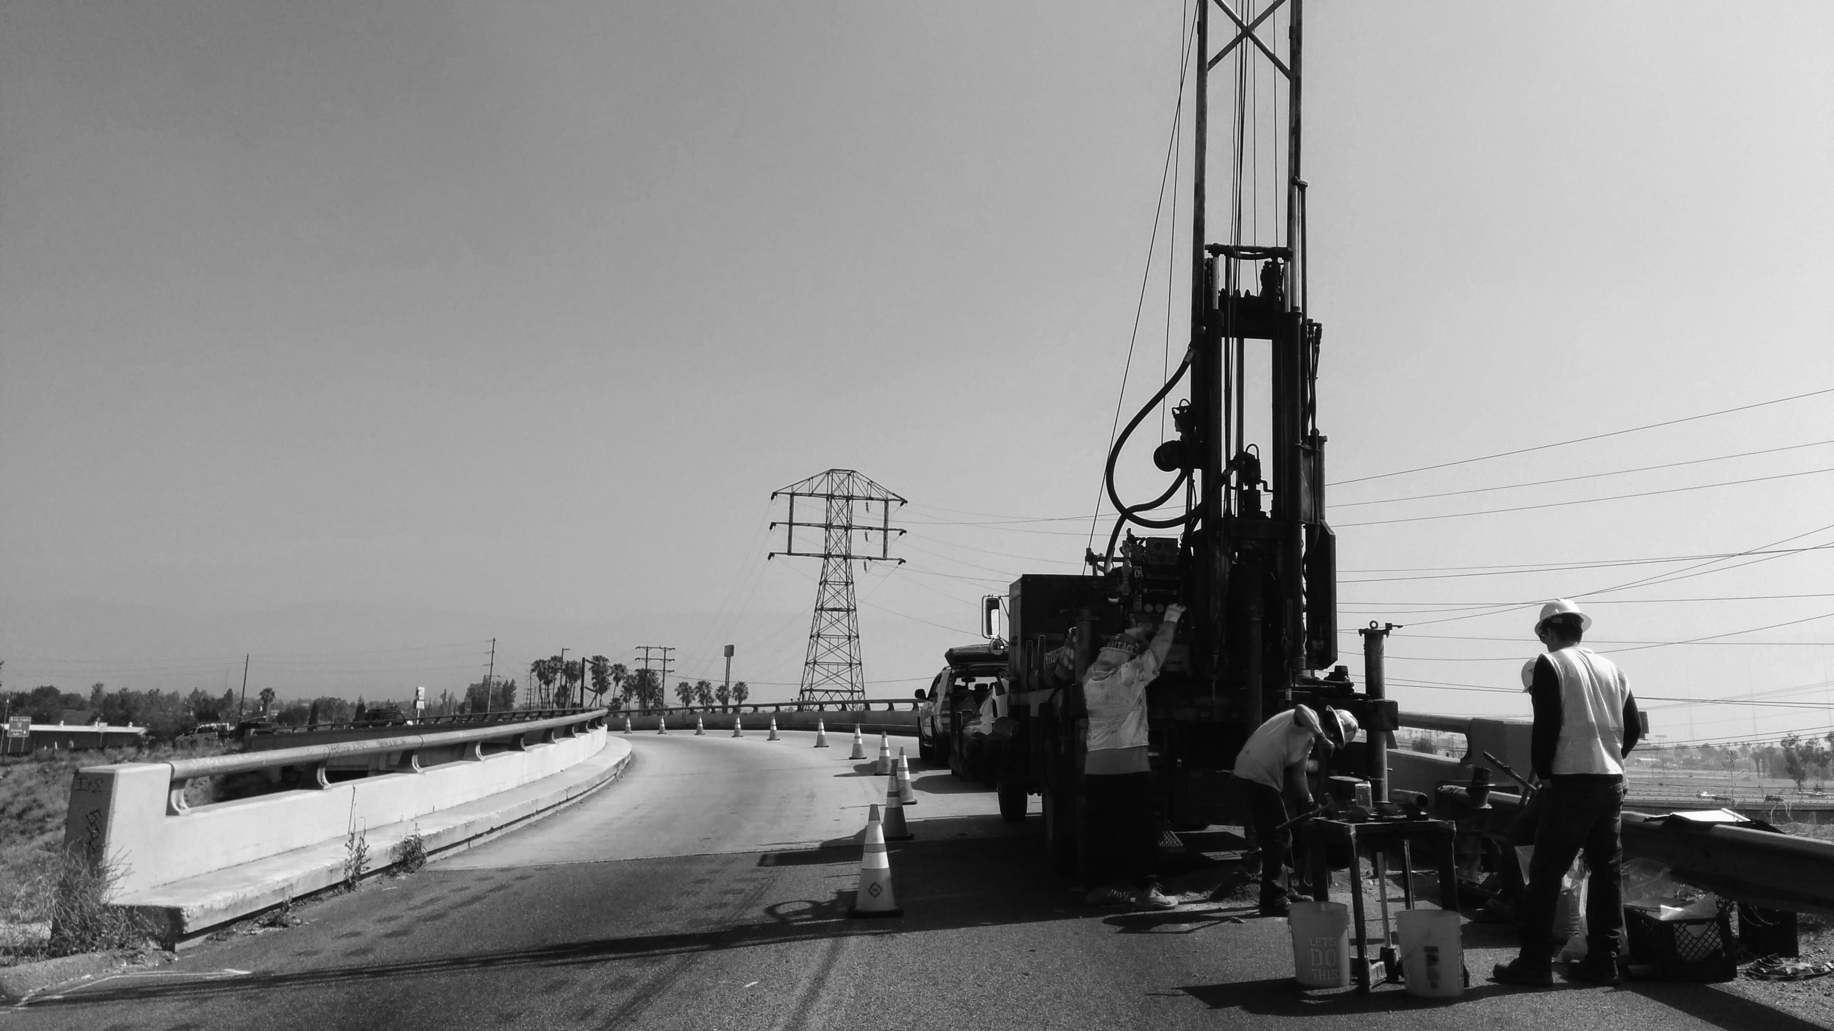

Anatomy of a Geotechnical Investigation Report
August 12, 2015
Notes:
1

Slide 2
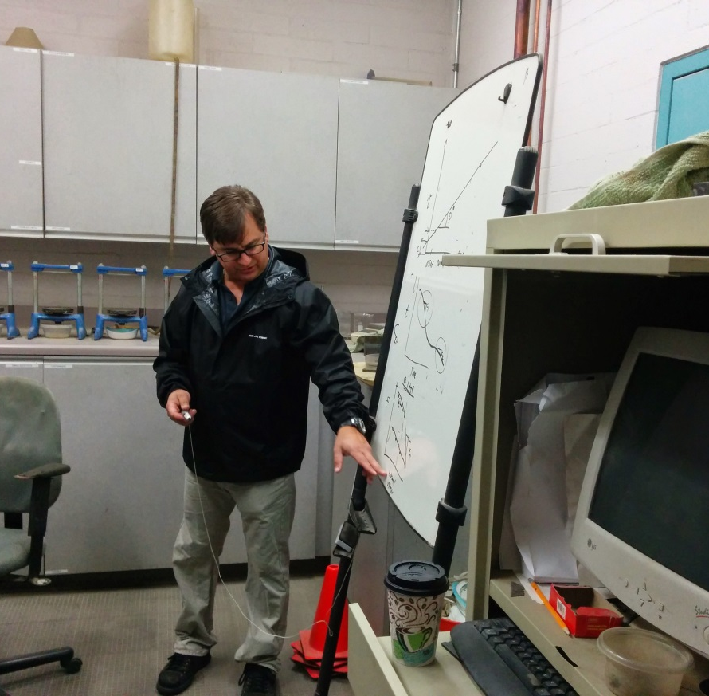
Presenters
Paul Soltis, PE, GE
Vice President of Geotechnical Engineering
Sean Lin, PhD, PE, GE
Chief Geotechnical Engineer
Andres Bernal, PhD, PE, GE
Senior Geotechnical Engineer

Slide 3
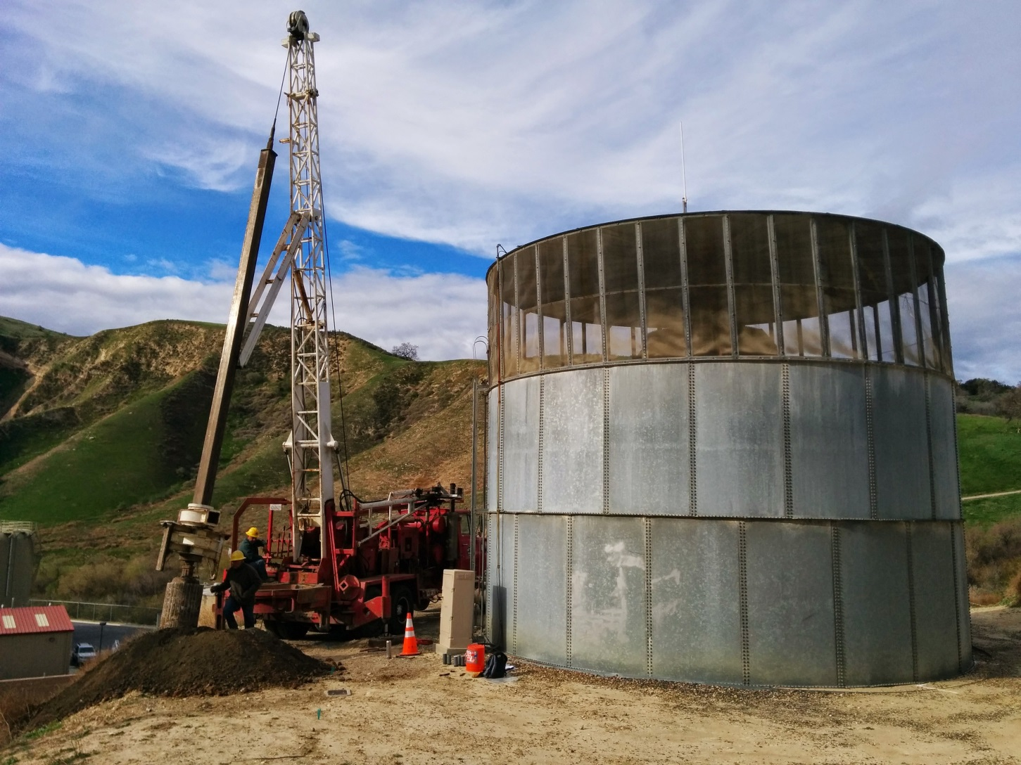
Why do we need a geotechnical report?

Slide 4
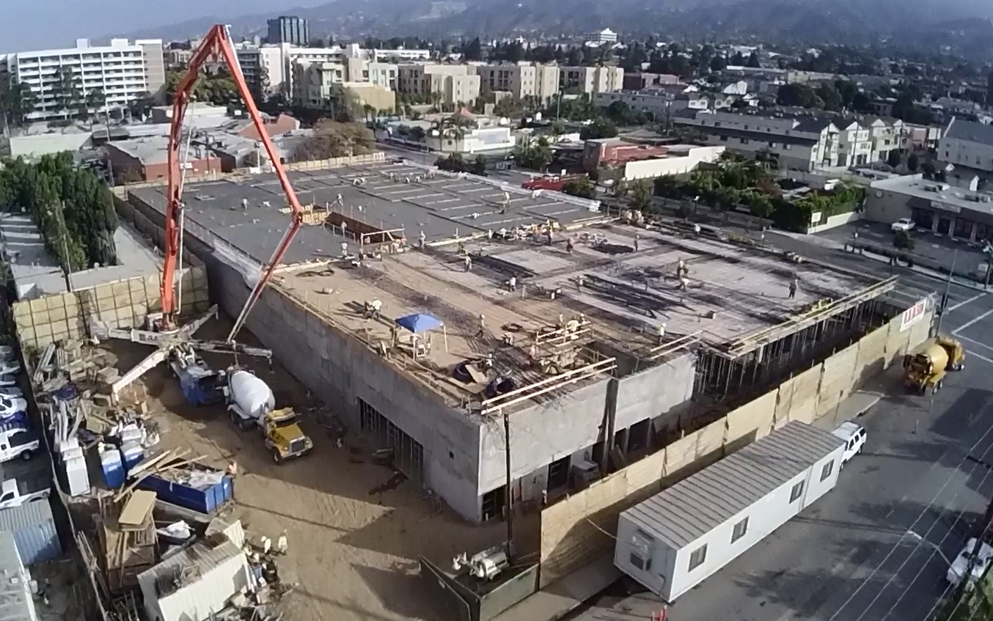
Because we have projects built on, or into, the ground…

Slide 5
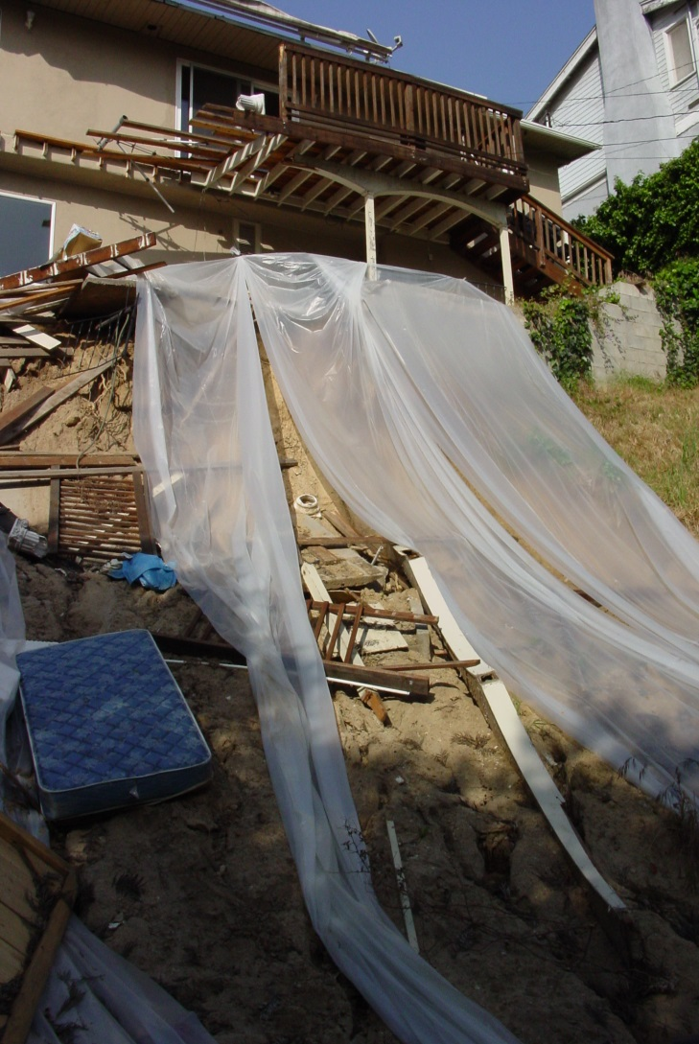
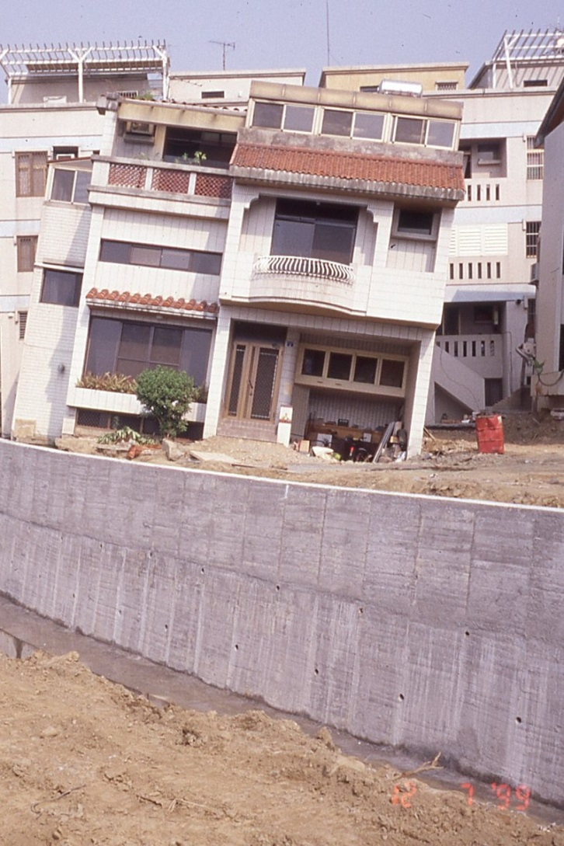
Because we have to mitigate instability of the ground…

Slide 6
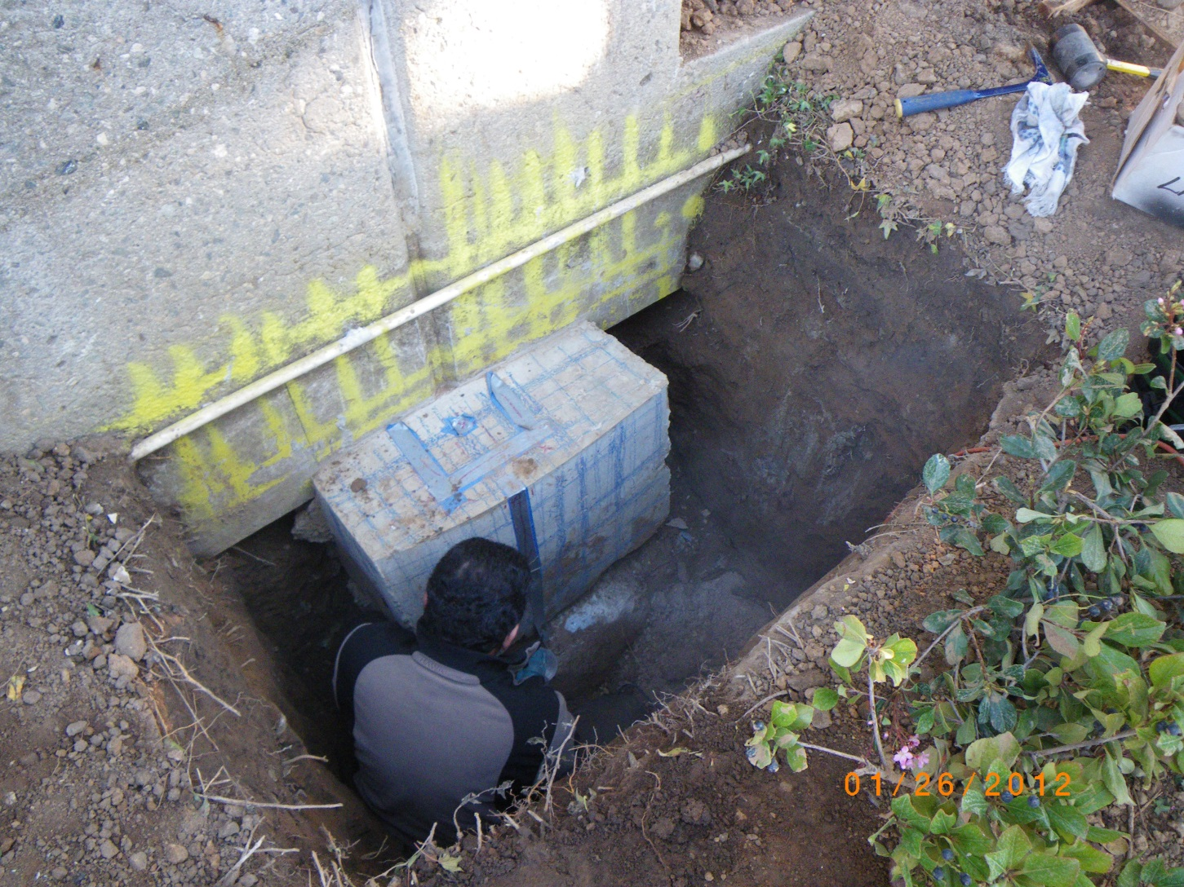
Because we have to know what was previously built…

Slide 7
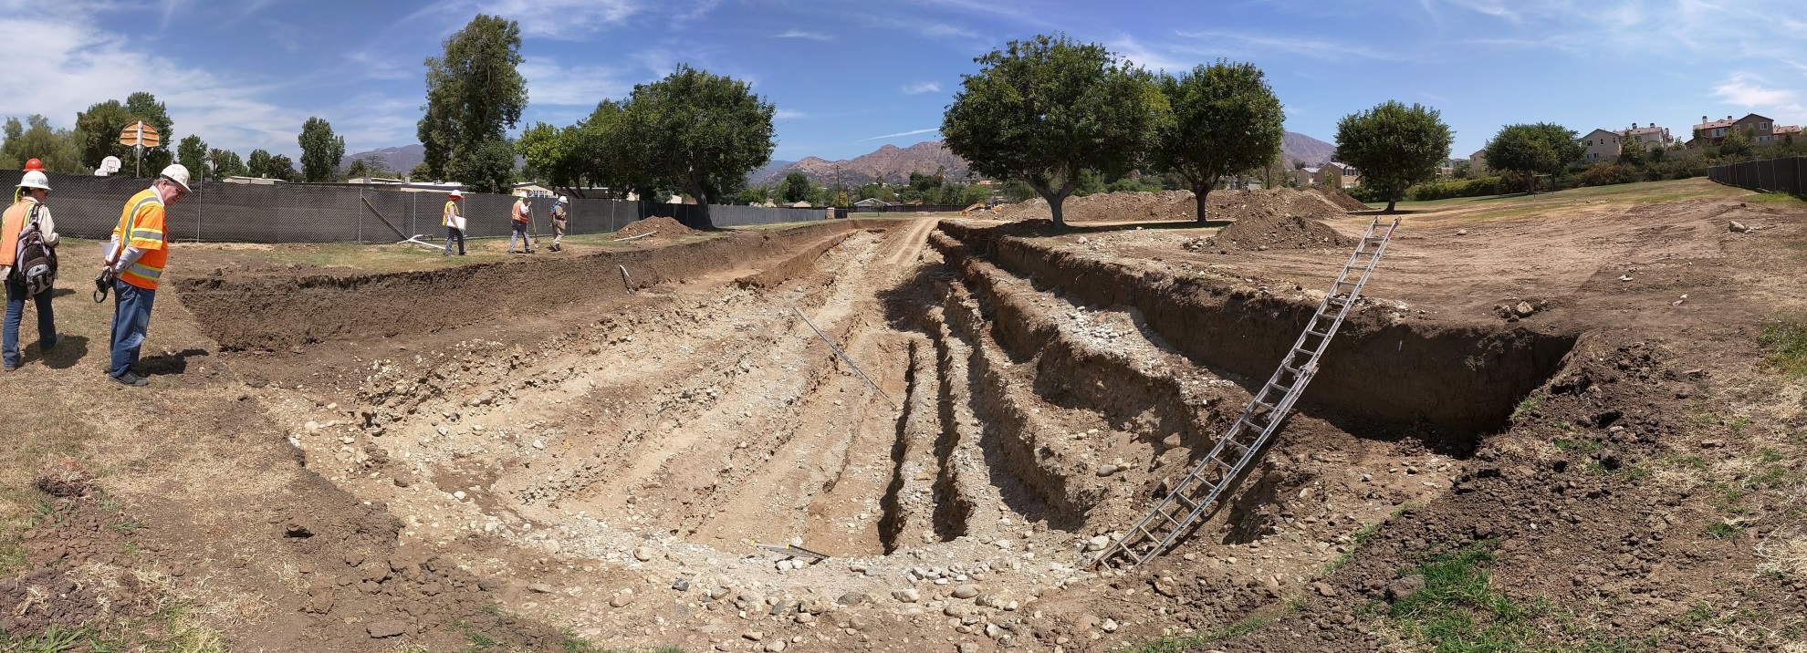
Because we have to determine if an active fault crosses the site…

Slide 8
Table of Contents - Geotechnical Report
Introduction and Site Description
Proposed Project and Scope of Services
Literature Review and Site Background Info
Field Exploration and Laboratory Testing
Regional Geologic Setting and Subsurface Conditions
  5.1. Regional Geology
    5.2. Geologic Hazard Zones: Surface Fault Rupture; Liquefaction; Landslides; Flooding & Seiches; Tsunamis
5.3. Soil Profile
5.4. Groundwater
Seismic Design Considerations
  6.1. Active Faulting 6.4. Liquefaction & Seismic Settlement Potential
  6.2. Historical Seismicity 6.5. Slope Stability
  6.3. Seismic Design Parameters (CBC/Caltrans)
7. Design Recommendations
  7.1. Earthwork and Site Preparation 7.5. Pavement Design
  7.2. Foundation System 7.6. Stormwater Infiltration
  7.3. Concrete Slab / Vapor retarder 7.7. Corrosion
  7.4. Retaining Walls

Slide 9
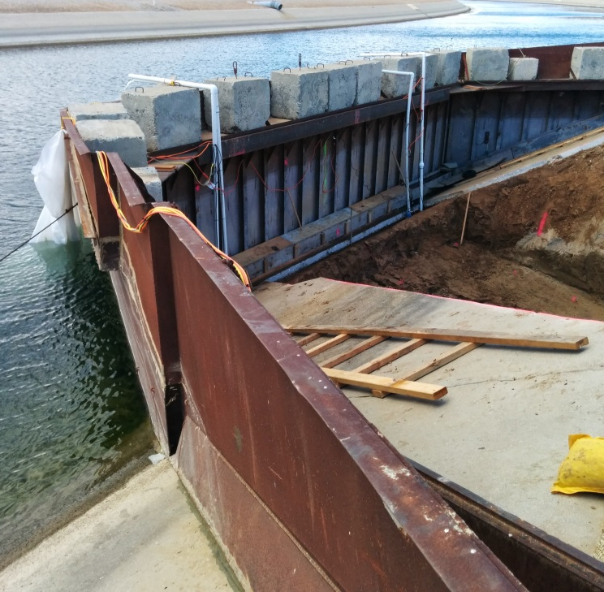
Proposed Project Types
Buildings
Parks/ Recreation Facilities
Water Tanks/Facilities
Bridges
Roadway pavement
Underground pipelines
Stormwater infiltration
Site stabilization
As-built verification
Tunnels
Dams/Levees

Slide 10
Who defines the project scope?
Civil Engineer
Architect
Client
Structural Engineer
Plan Reviewer
Transportation Engineer
Geotechnical Engineer

Slide 11
Literature Review and Site Background Information
Notes:
11

Slide 12

Literature Review / Site Background Info
Geologic Maps
Available Geotech/Geologic reports
City/County/Caltrans database and archive
USGS/CGS
Google Earth
Geotracker
Historical Aerial Photos

Slide 13
Field Exploration
Notes:
13

Slide 14
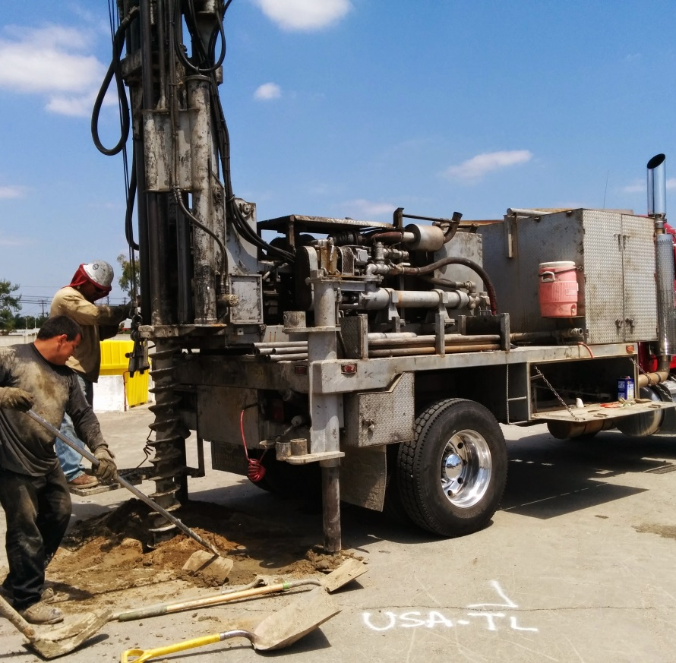
Field Exploration
Soil Borings
Cone Penetration Testing
Downhole logging
Test Pits
Test Trenches
* Details are usually presented in Appendix A

Slide 15
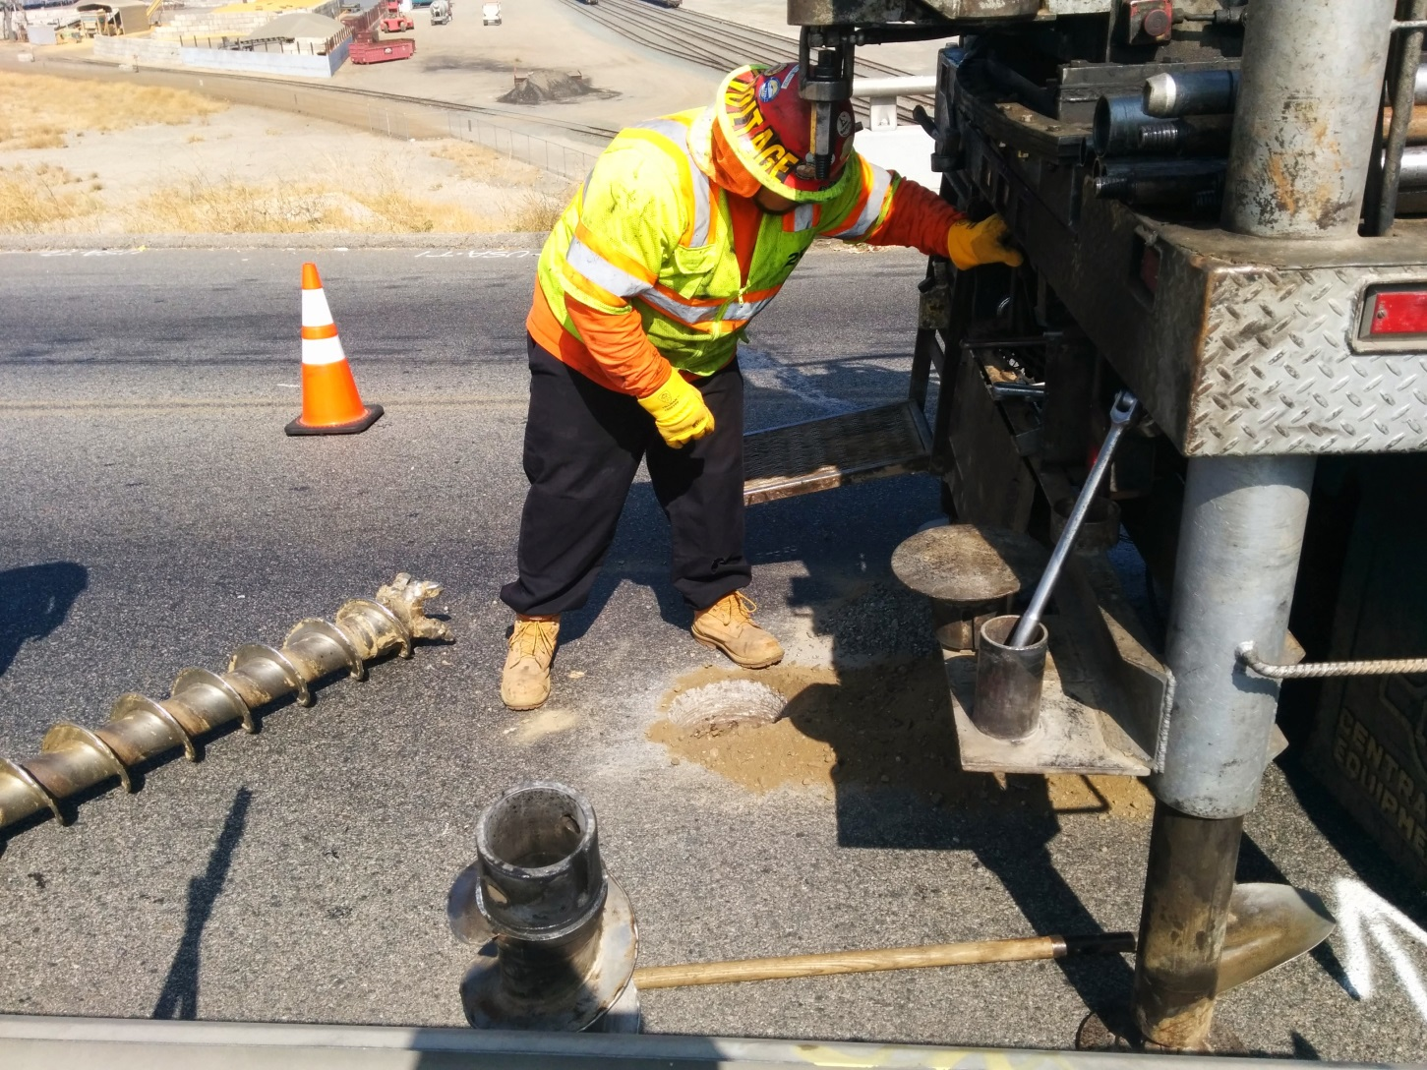
Hollow-Stem Drill Rig

Slide 16
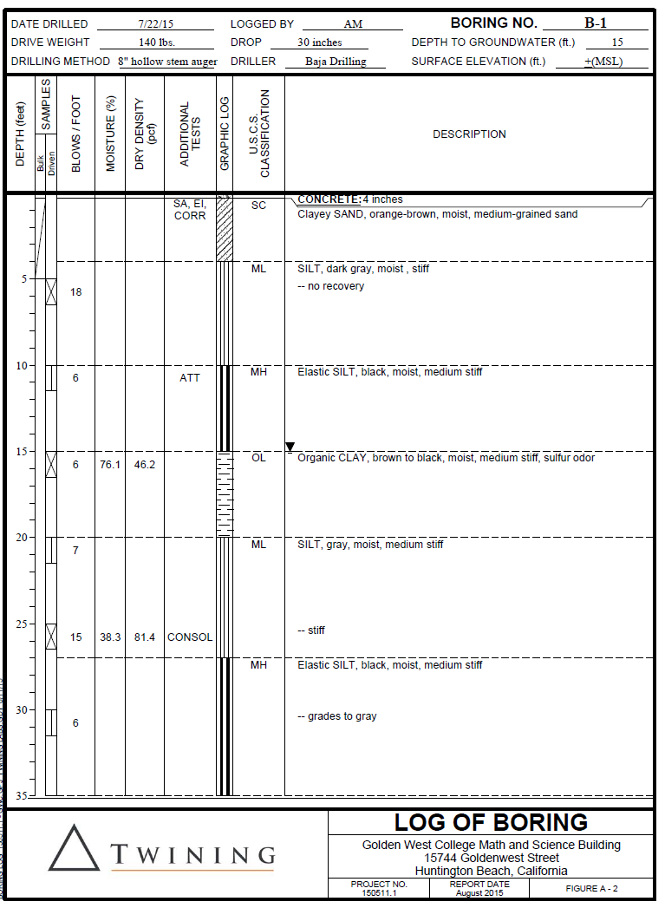
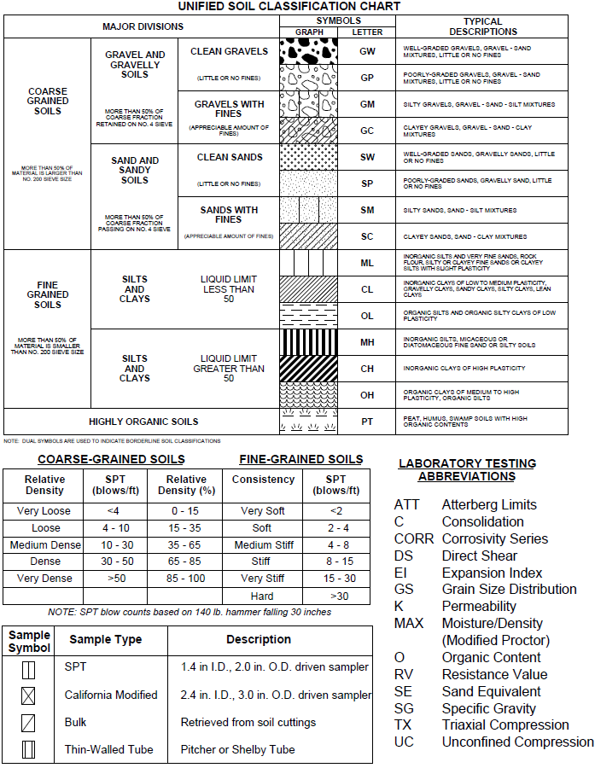
Boring Logs

Slide 17
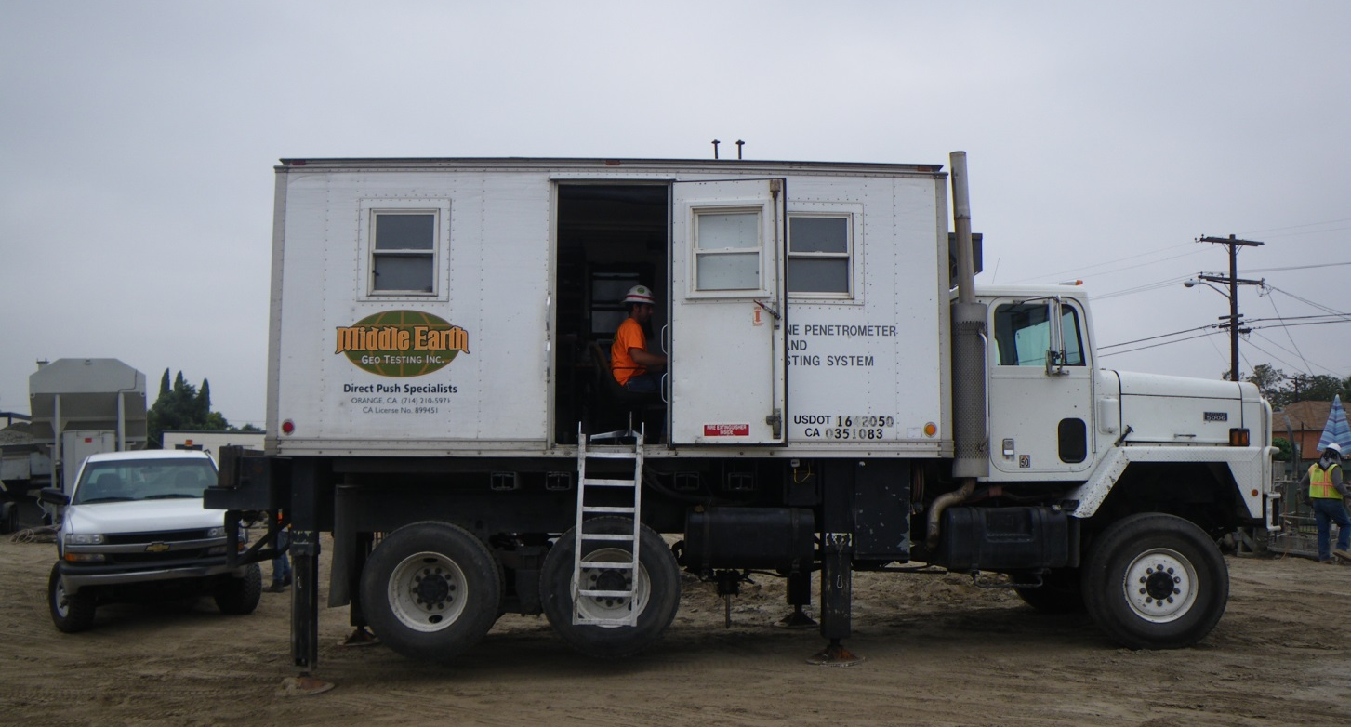
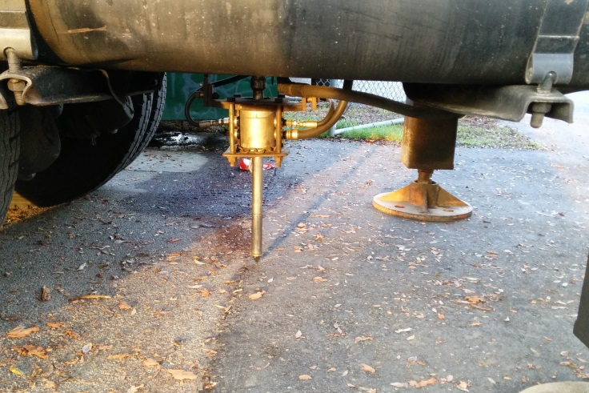
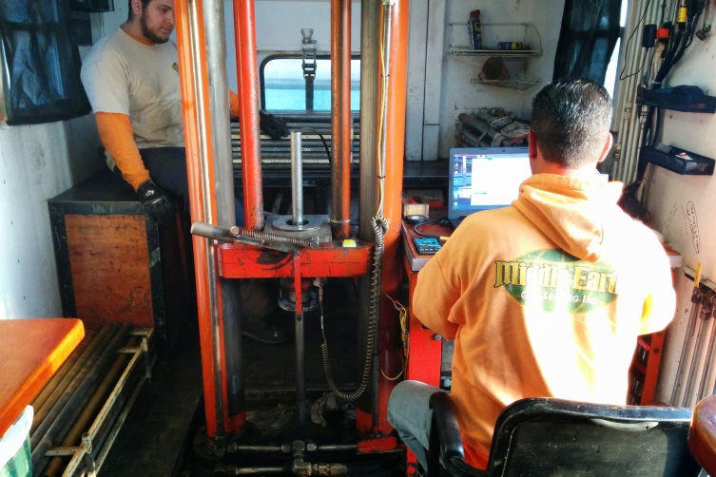
Cone Penetration Testing Rig

Slide 18
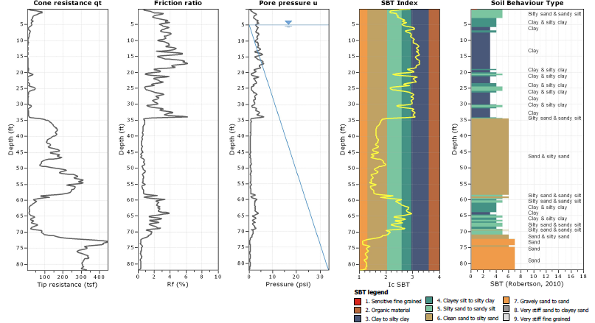
CPT Logs
CPT probe records:
  Tip resistance – q_{t}
  Sleeve friction – f_{s}
  Pore water pressure – u

Slide 19
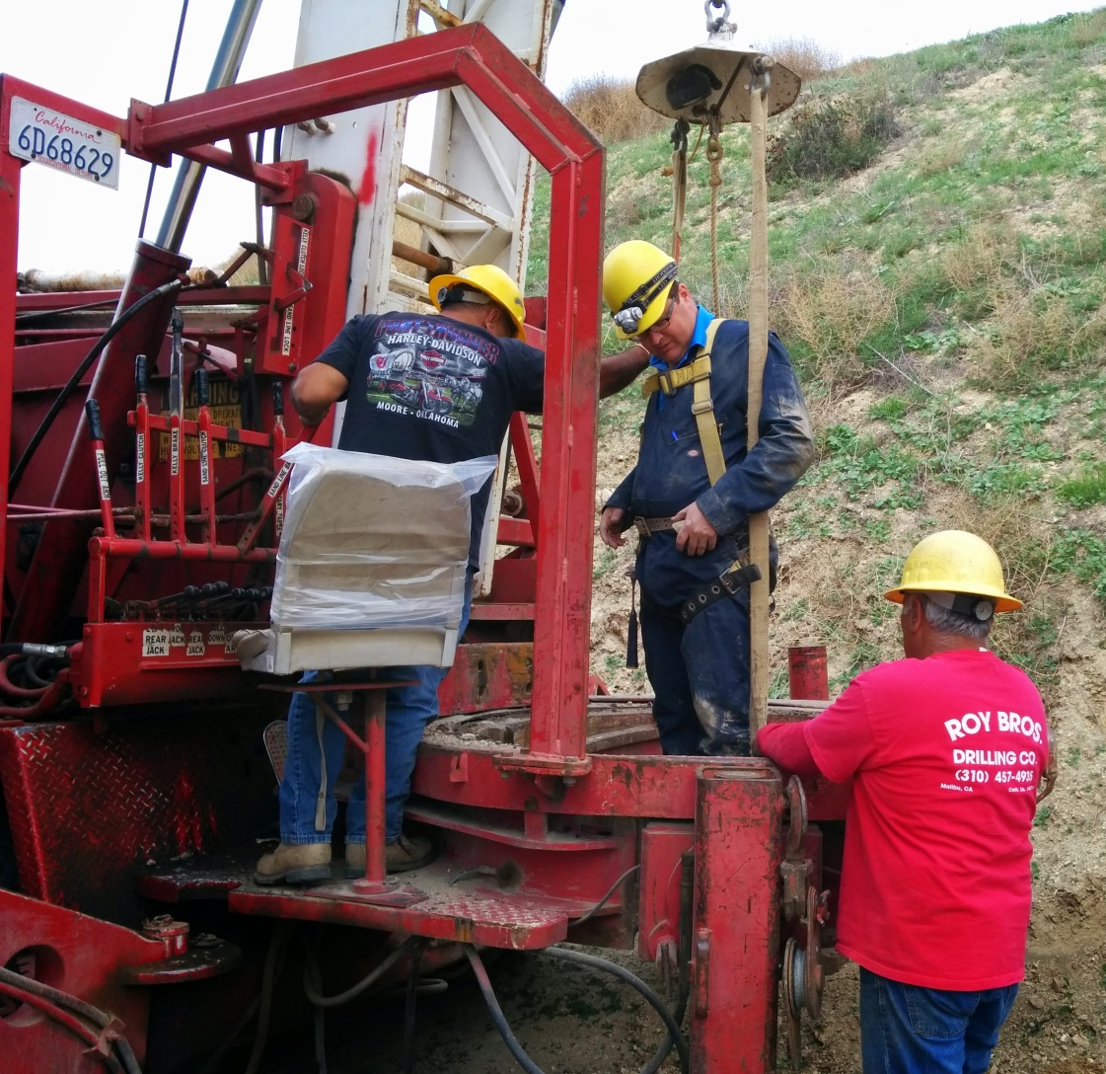
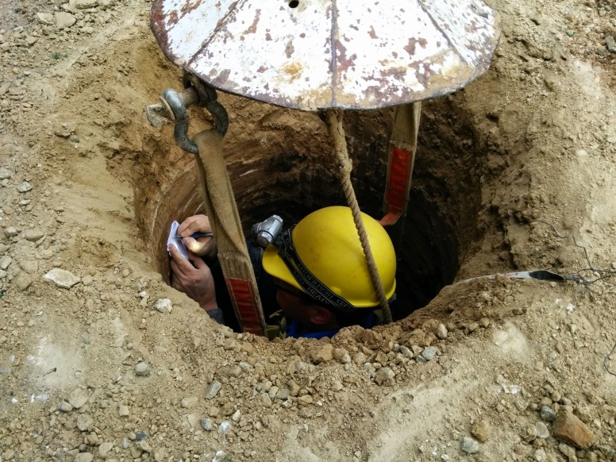
Downhole Logging

Slide 20
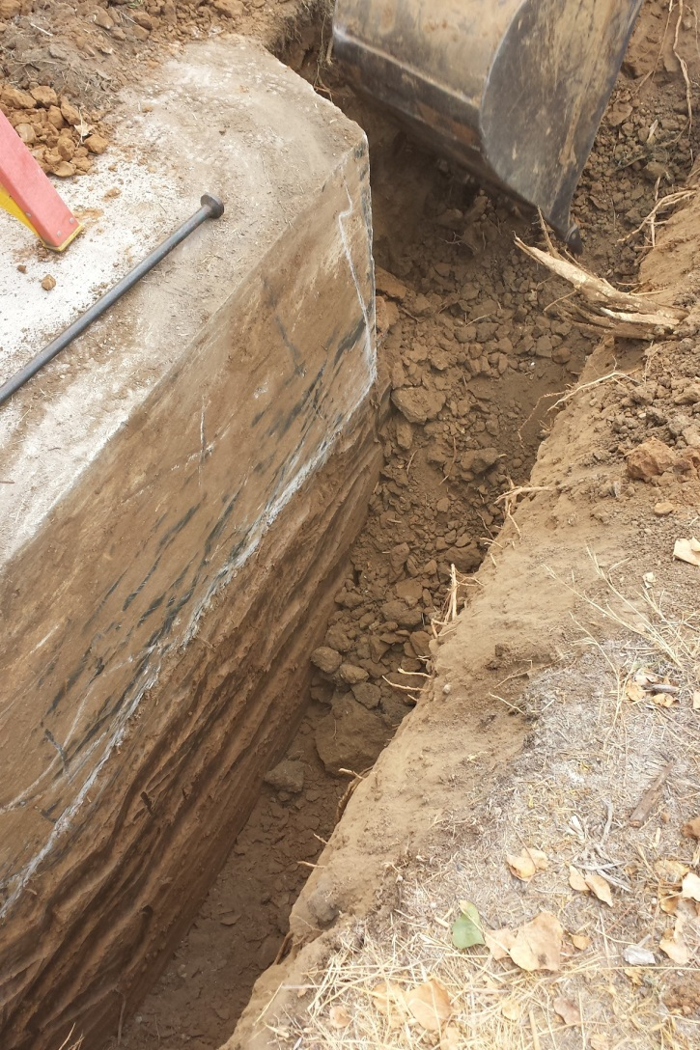
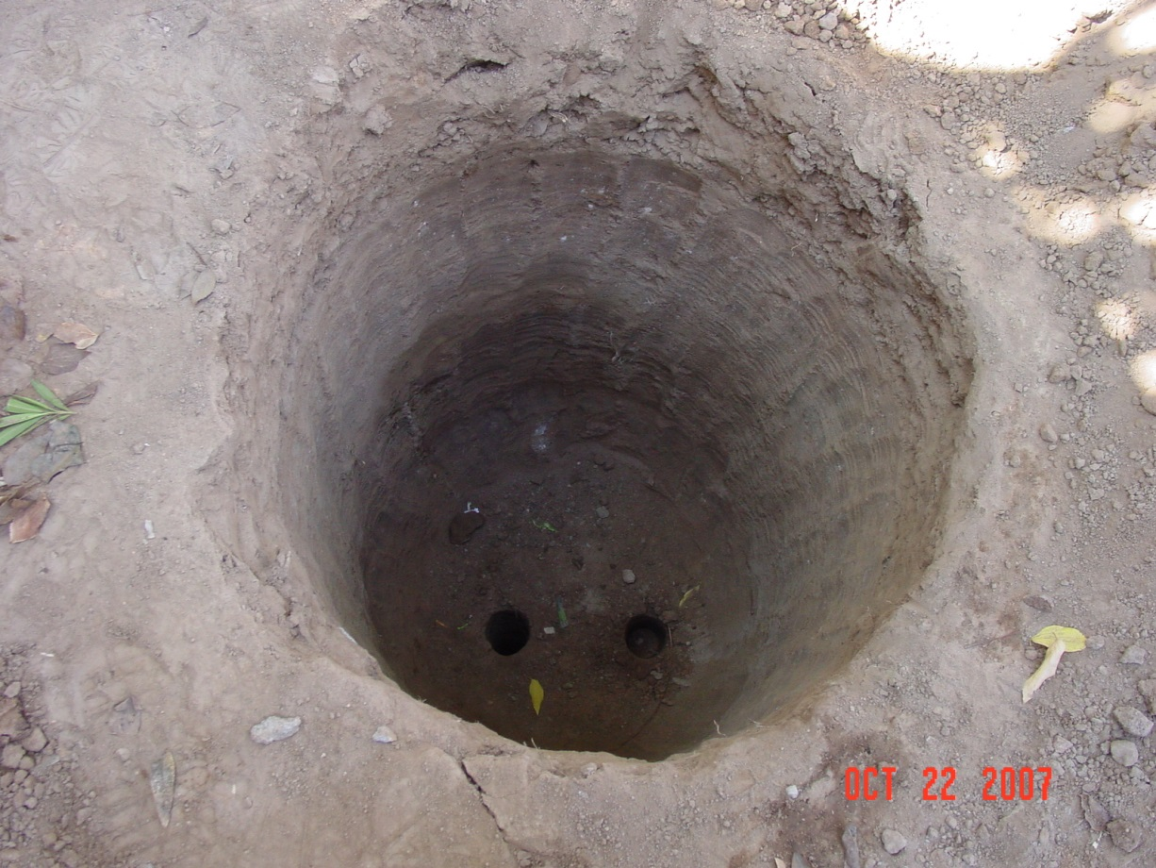
Test Pits/Potholes

Slide 21
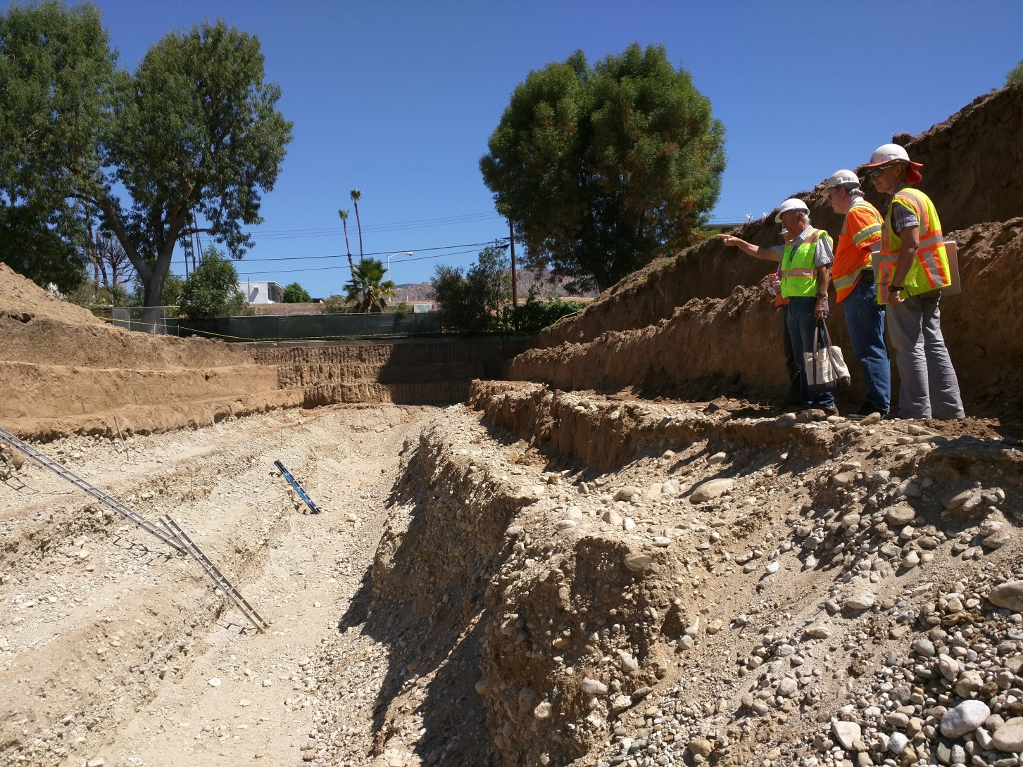
Fault Trenches

Slide 22
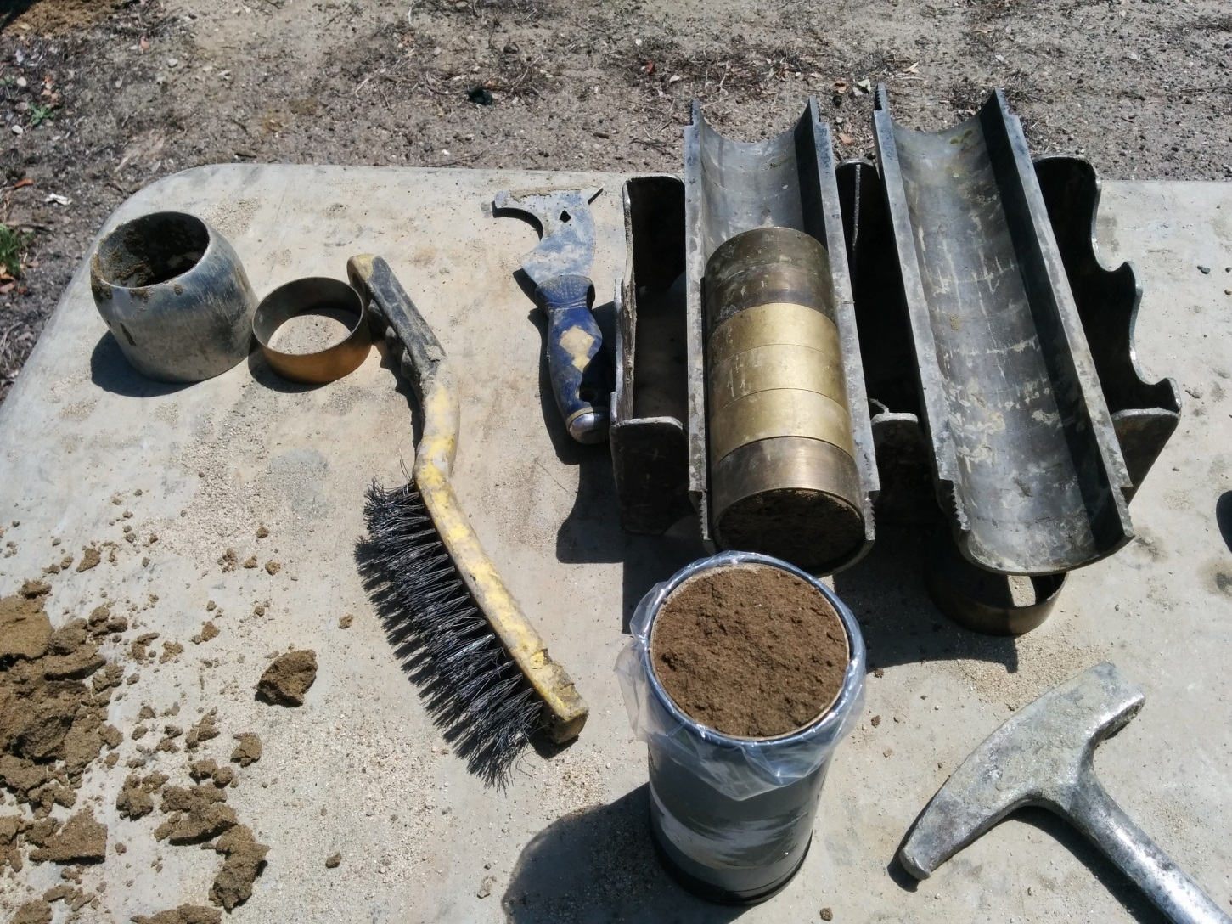
Soil Samples

Slide 23
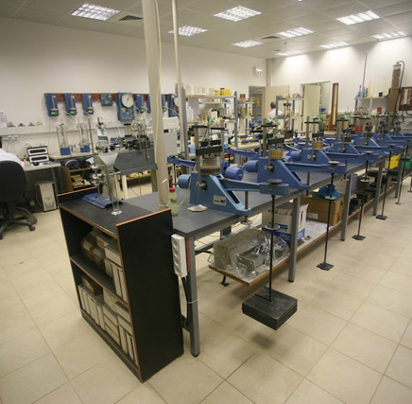
Geotechnical Laboratory Testing
Soil Classifications
Sieve Analysis
Atterberg Limits
Expansion Index
Direct Shear
Consolidation
Maximum Density
Corrosivity
R-value, CBR
Triaxial Test

Slide 24
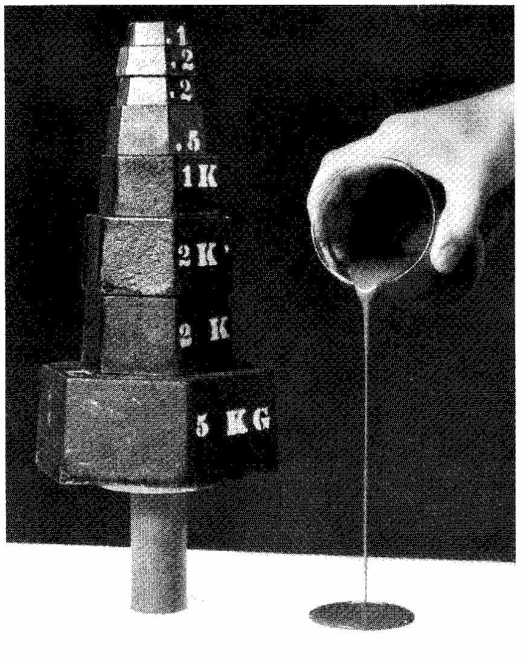
What do we look for?
Soil/rock characteristics
Soil/rock strength
Load-deflection relation
* Test results are usually included in Appendix B

Slide 25
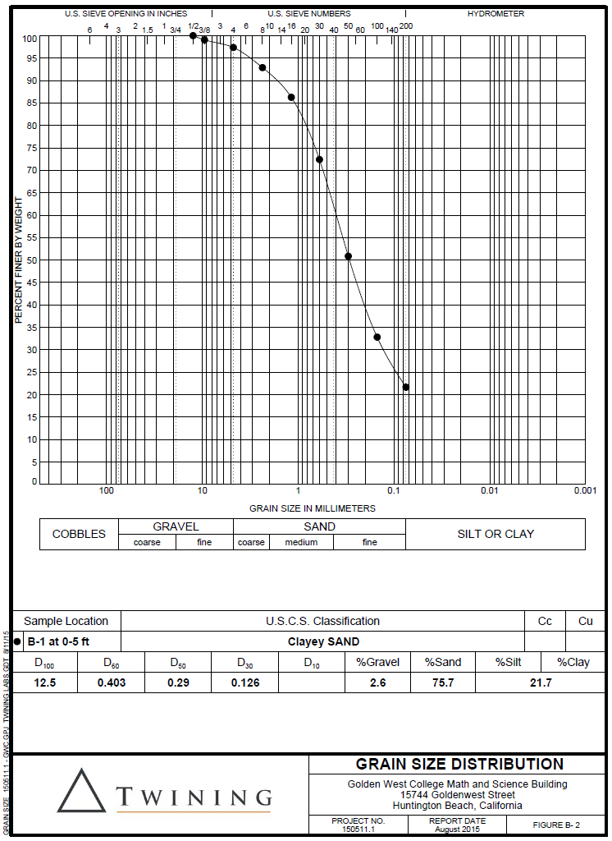
Sieve Analysis
To determine particle size distribution
Establish soil classification

Slide 26
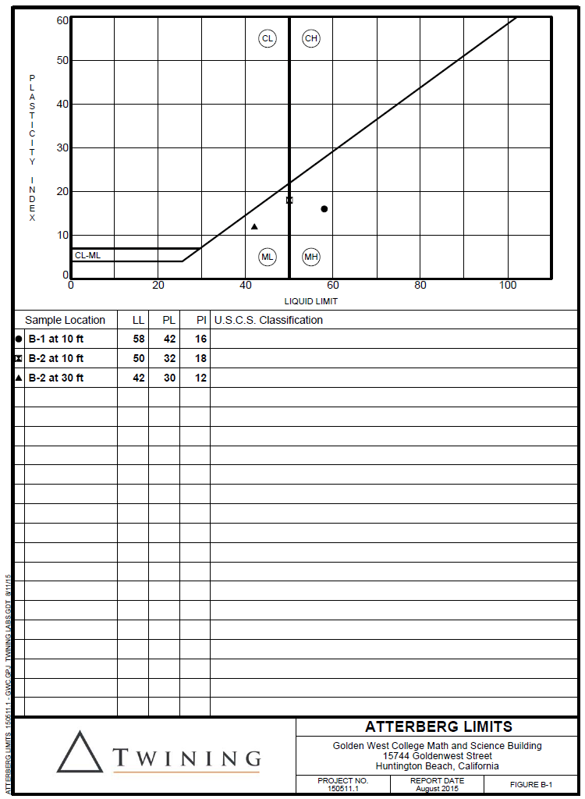
Atterberg Limits
To determine Liquid Limit, Plastic Limit and Plasticity Index for fine grained soils (clay/silt)
Establish soil classification
Indication of expansion potential

Slide 27
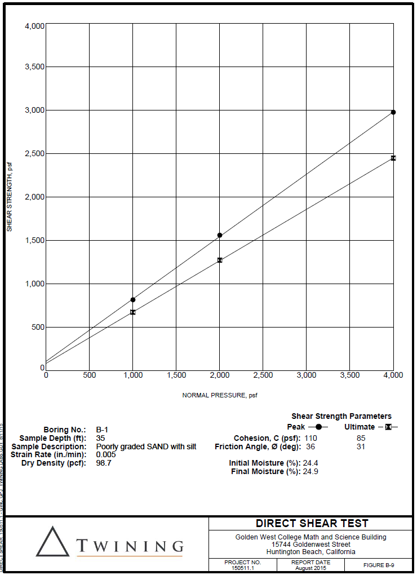
Direct Shear Test
To determine shear strength parameters of soil

Slide 28
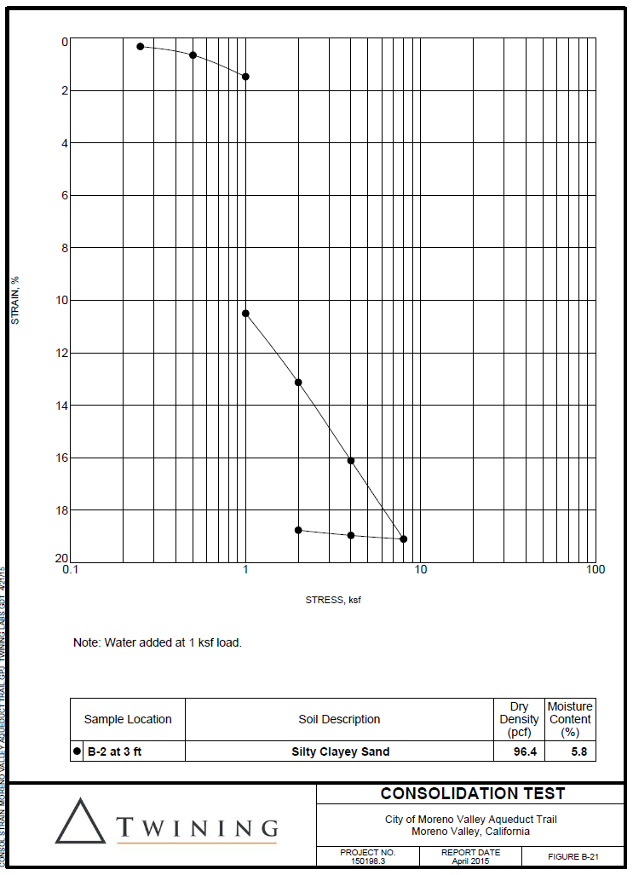
Consolidation Test
To determine load-deflection relation of soil (especially for fine grain soils)
Evaluate collapse potential

Slide 29
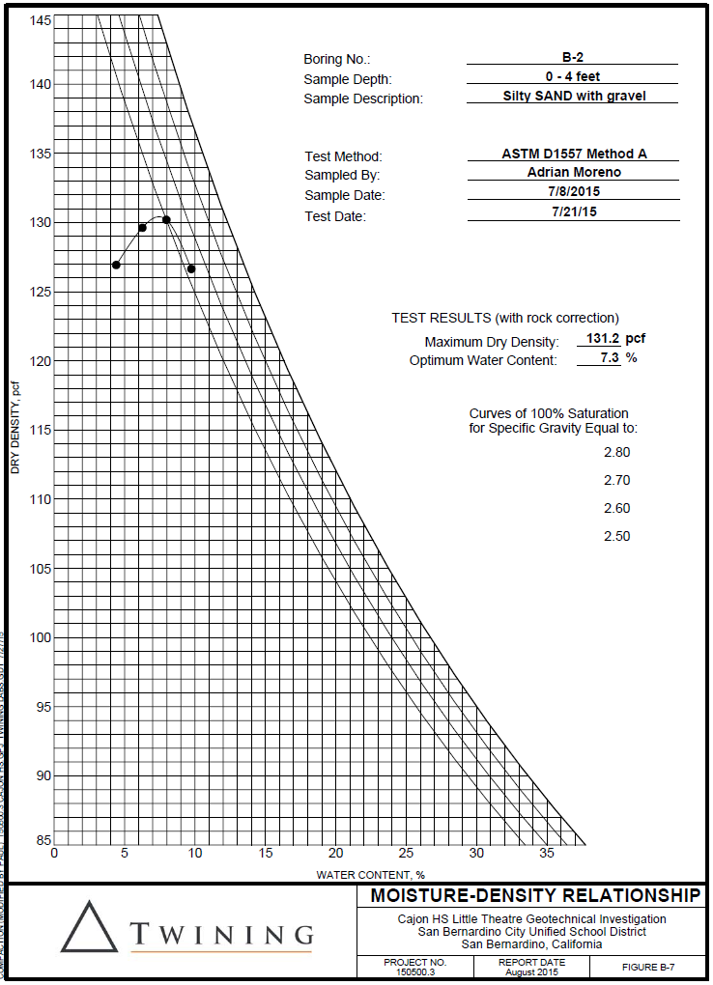
Maximum Density (Proctor) Test
To determine the moisture-density relation for compaction

Slide 30
Regional Geologic Setting & Subsurface Conditions
Notes:
30

Slide 31
Regional Geologic Setting & Subsurface Conditions
Site Geology
Geologic Hazard Zones
  Surface Fault Ruptures
  Liquefaction
  Landslides
  Flooding & Seiches
  Tsunamis
Soil Profile
Groundwater

Slide 32
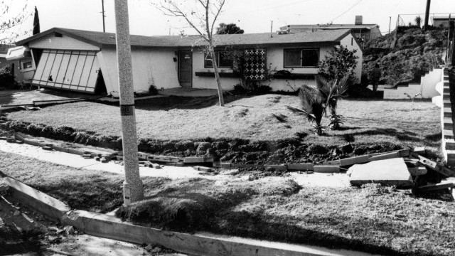
Surface Fault Rupture

Slide 33
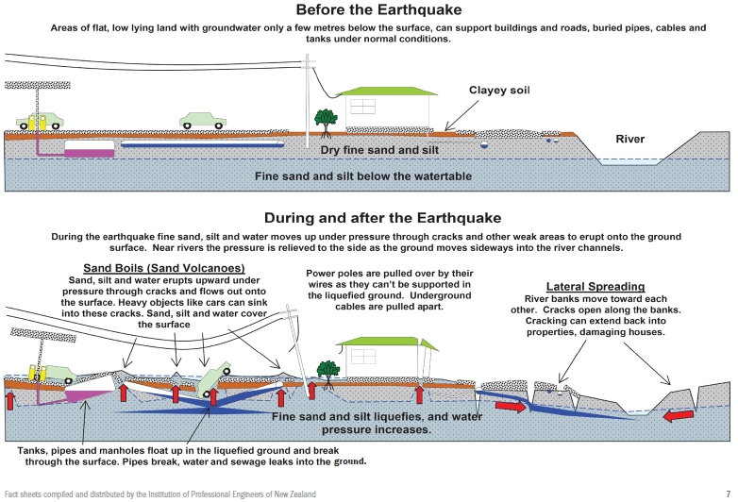
Liquefaction and its Effects

Slide 34
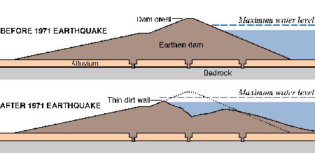
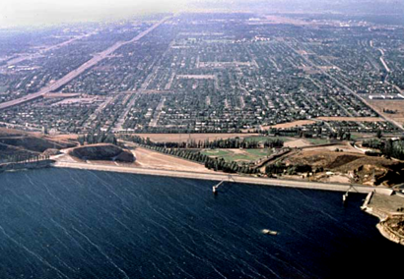
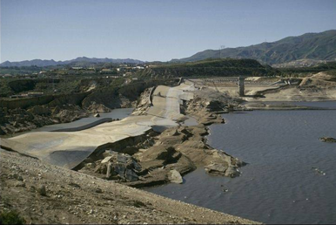
Landslides

Slide 35
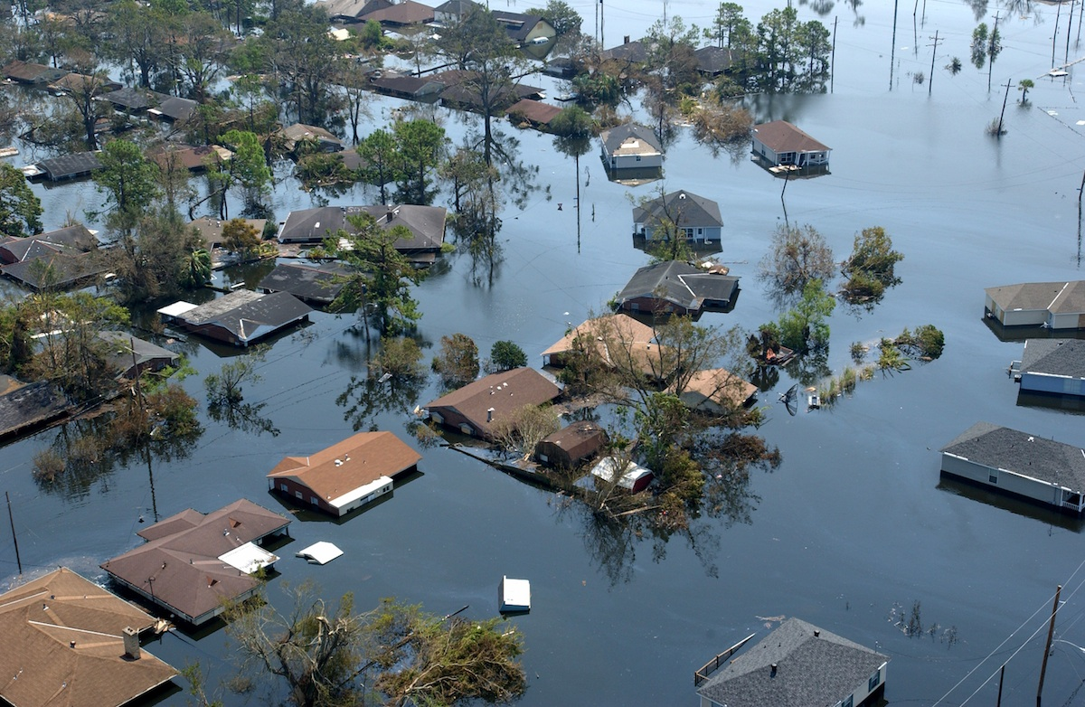
Flooding & Seiches

Slide 36
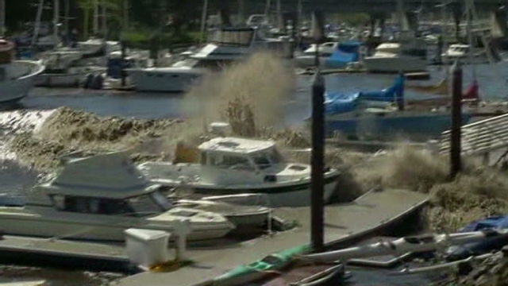
Tsunamis

Slide 37
Seismic Design Considerations
Notes:
37

Slide 38
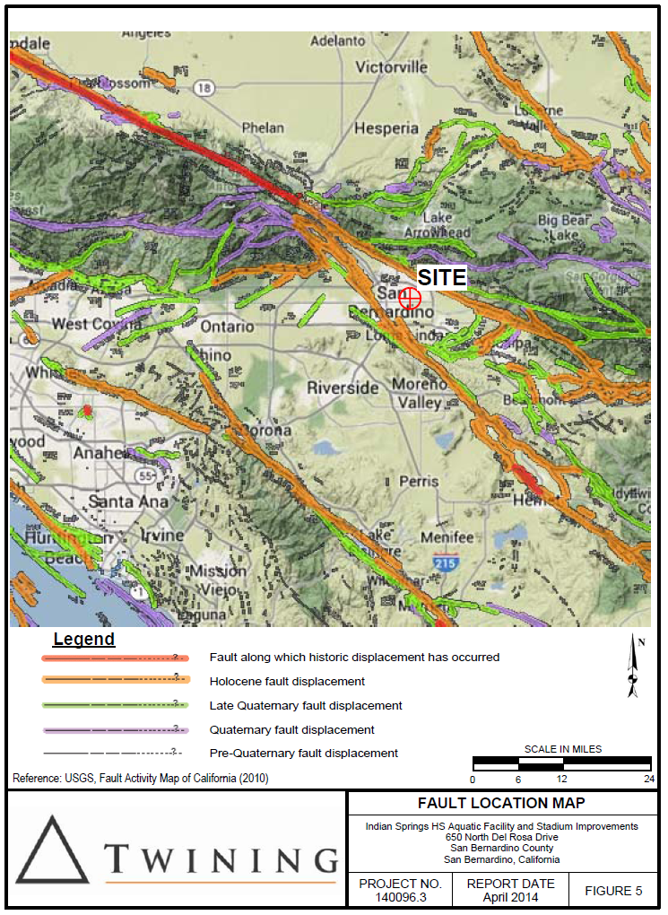
Seismic Design Considerations
Active Faulting
Historical Seismicity
Seismic Design Parameters/ Spectrum
Liquefaction & Seismic Settlement Potential
Slope Stability

Slide 39
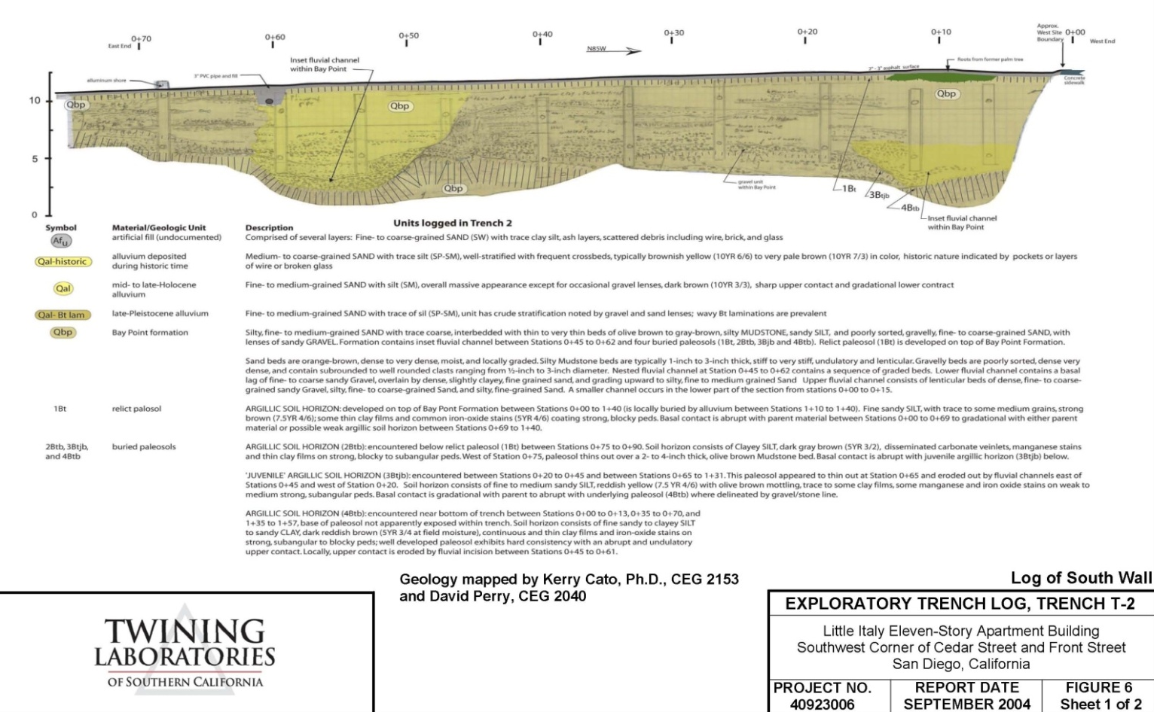
Active Faulting
Alquist-Priolo Earthquake Fault Map
USGS Deaggregation website
Caltrans ARS online

Slide 40
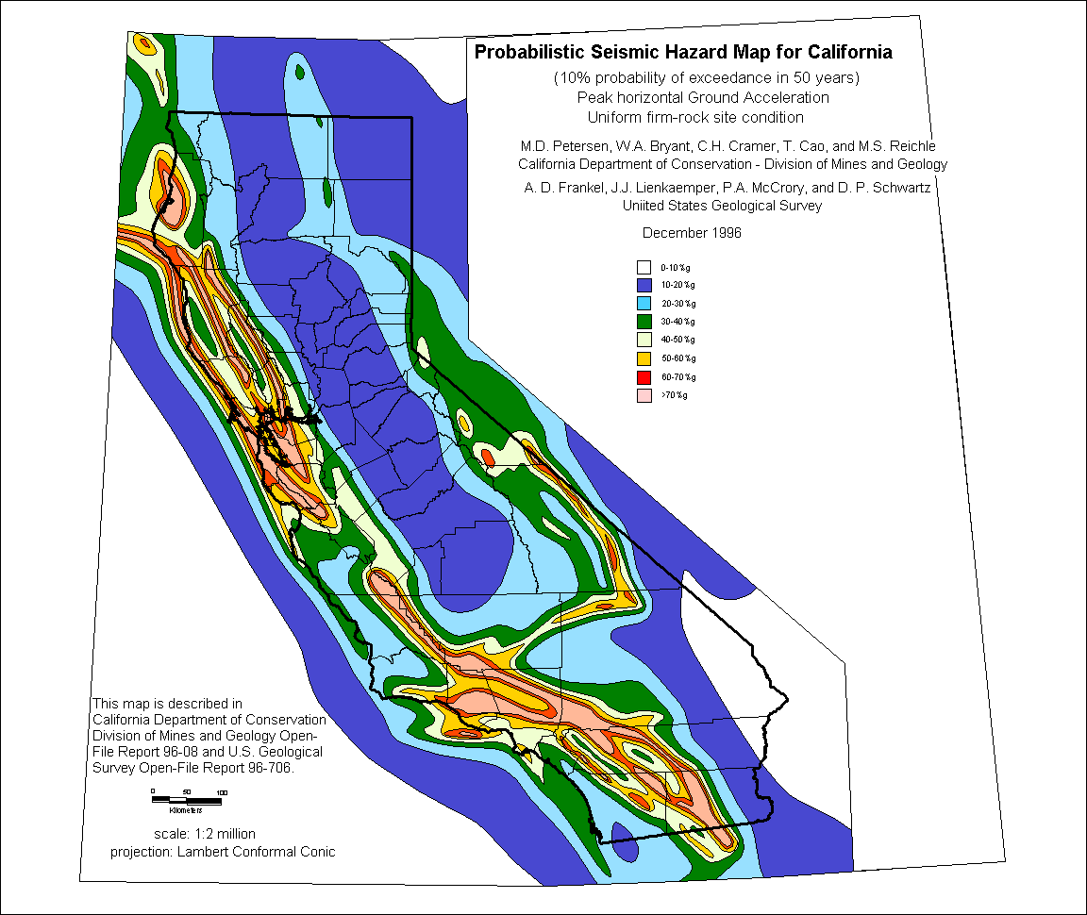
Historical Seismicity
USGS/CGS data base
SC/EC data base
Probabilistic analysis
Probabilistic analysis
Site-specific acceleration
response spectrum

Slide 41
Seismic Design Parameters/Spectrum
USGS Seismic Design Map

Slide 42
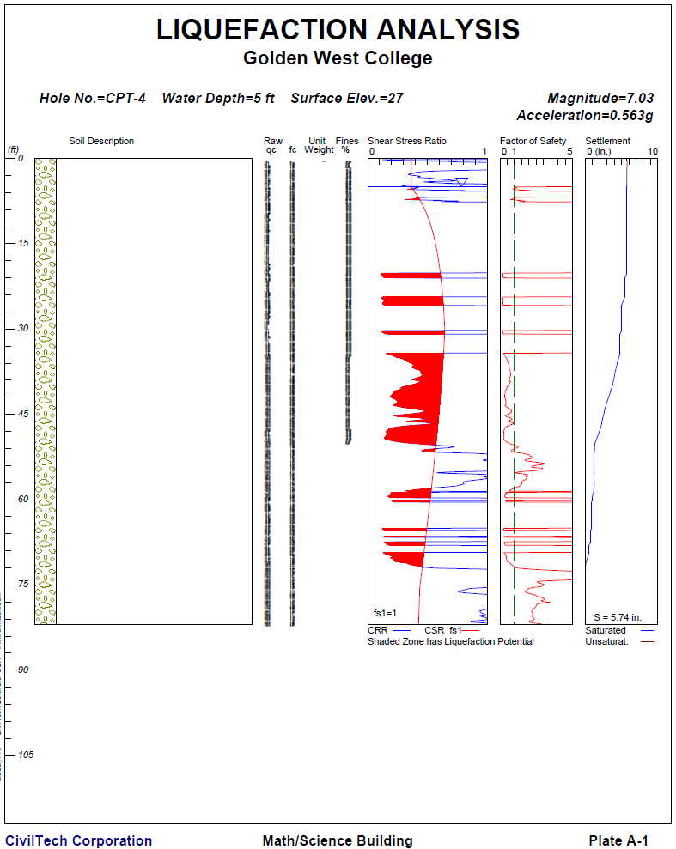
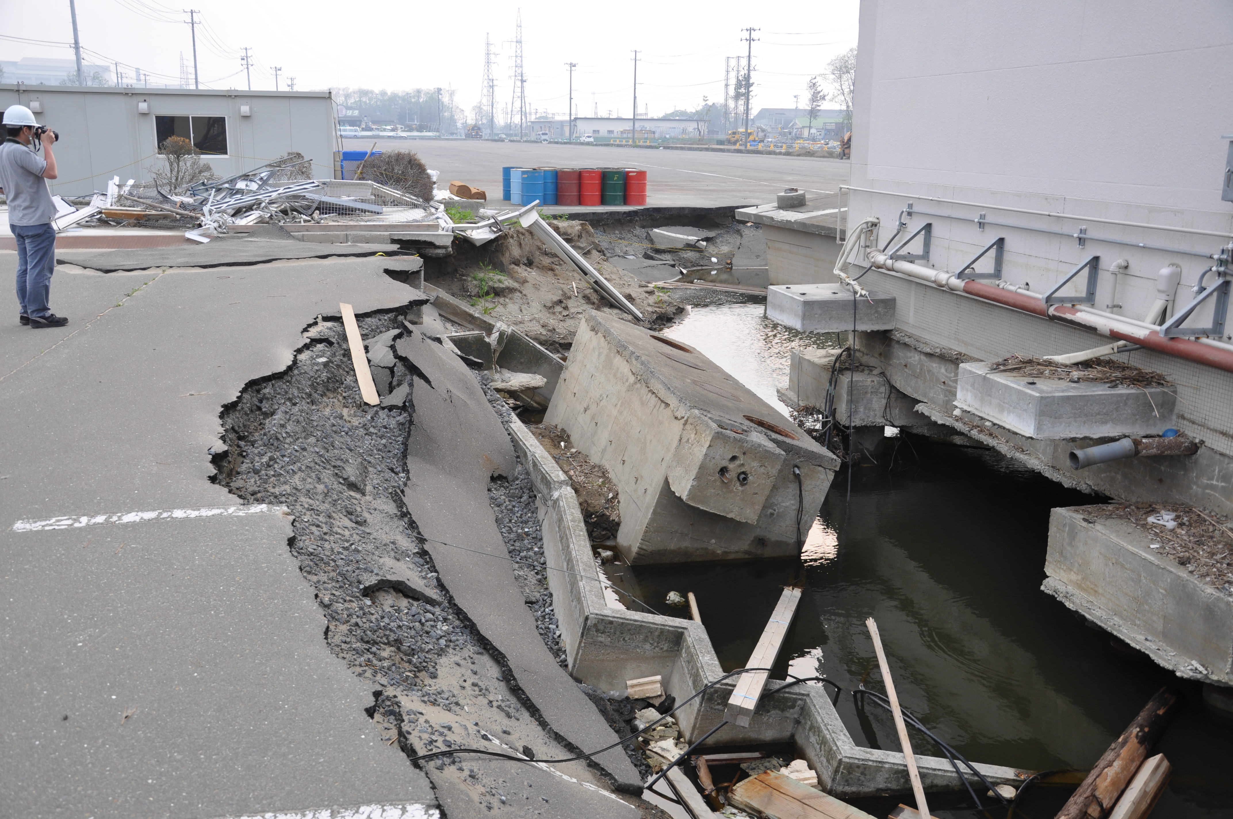
Liquefaction & Seismic Settlement Potential

Slide 43
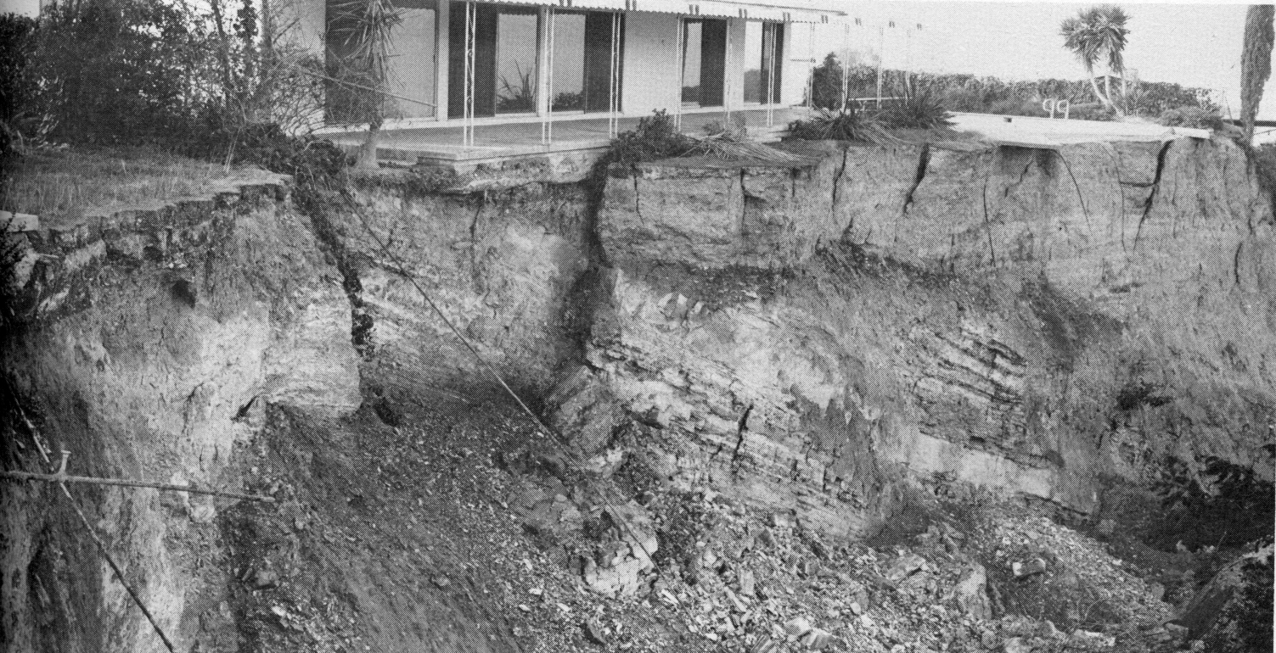
Slope Stability
Adverse bedding
slope failure

Slide 44
Design Recommendations
Notes:
44

Slide 45
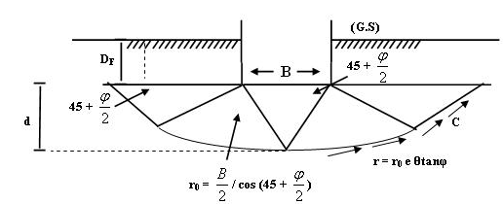
Design Parameters
Bearing capacity
Lateral resistance
Concrete/soil friction
Lateral earth pressures
Settlement
Subgrade reaction
Seismic design parameters
Seismic settlement / Lateral spreading
Seismic earth pressures

Slide 46
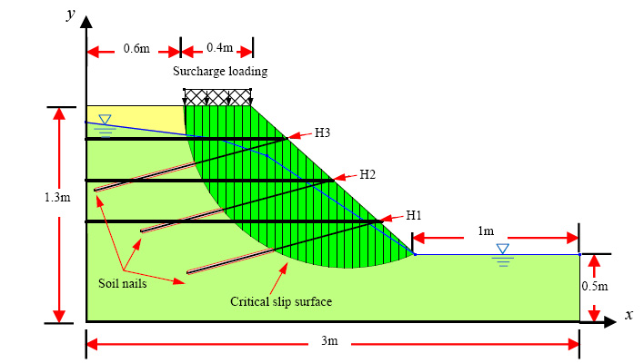
Engineering Analyses - Static
Soil Classification
Soil Strength
Expansive soil
Corrosive soil
Ground deflections
  Vertical settlement
  Lateral deflection
Site stability
Slope Stability

Slide 47
Earthwork and Site Preparation
Ground Improvement
  Shallow (compaction)
  Deep (deep dynamic compaction, compaction grouting, soil mixing, chemical grouting, etc.)
Grading Issues – Buildings
      Remedial grading - removal and replacement of support soils
      Often required to minimize settlement
                - Could be extensive and costly (e.g., remove and replace five feet below footings)
  Expansive soil mitigation measure
    - Below building slab and flatwork (e.g., remove and replace upper two feet with low expansive soil below slabs)

Slide 48
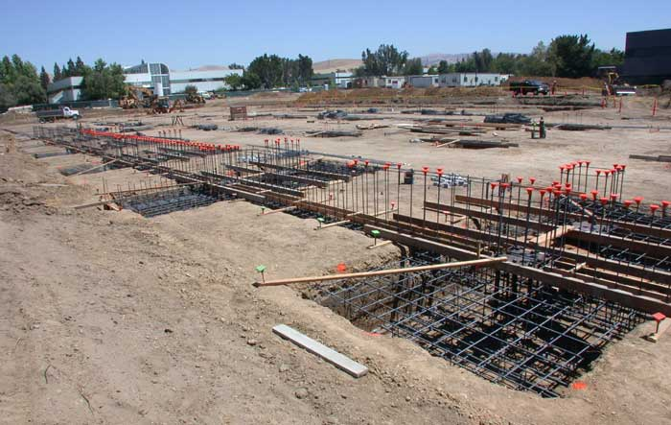
Foundation System
Structural Solutions
  Shallow Foundations
  Mat Foundation
  Intermediate Foundations (Geopiers)
  Deep Foundations

Slide 49
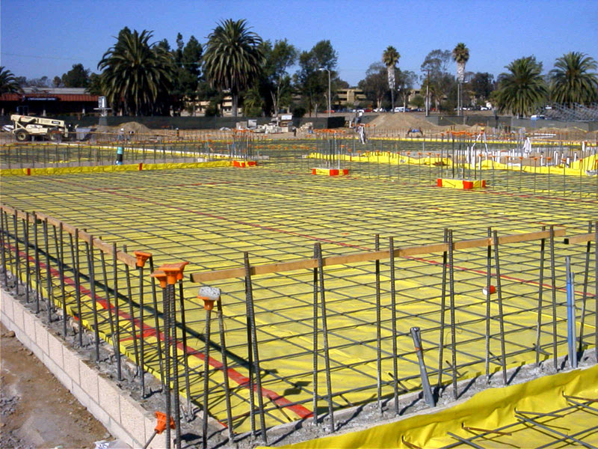
Concrete Slab / Vapor Retarder
Vapor Retarder Below Slabs
  Generally 10-mil vapor retarder in middle of 4 inches of sand
  Often 15-mil vapor barrier (Stego Wrap or similar), durable barrier
  15-mil can be laid directly on subgrade with minimal rock
  Concrete can be placed directly on vapor barrier - provisions for mitigation of curling

Slide 50
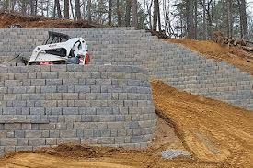
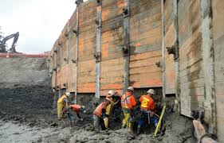
Retaining Walls
Lateral Earth pressures
Wall Drainage
MSE/Keystone Walls
Permanent shoring /
temporary excavations

Slide 51
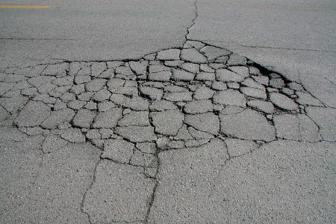
Pavement Design
Grading Issues – Pavements
  Soft, wet subgrade - stabilization prior to construction
  Achieve unyielding subgrade below pavements (no pumping)
  Caltrans HDM Ch. 600 (R-Value, TI)
  AASHTO (CBR)

Slide 52
Stormwater Infiltration
On-site Containment of Storm Water
  Local agencies require evaluation to minimize effects on storm water systems and pollutant runoffs.
  Projects with 5,000 sq. ft. of impervious surface need evaluation
  Geotechnical Engineer evaluates feasibility of infiltrating storm water based on information provided by Civil Engineer.
    Civil Engineer provides location, type and depth of BMP
    Geotechnical Engineer performs field testing
      Depth to groundwater (current/historic)
      Infiltration rate
  Civil Engineer evaluates options based on infiltration rates, design rain event, and storage capacity

Slide 53

Corrosion
Evaluate potential for soil to corrode buried concrete and metal structures
  Resistivity
  pH
  Sulfate
  Chloride

Slide 54
Post-Report Consultation Services
Notes:
54

Slide 55
Project Plans and Specifications
Geotechnical Engineer Involvement
  Grading and Structural Plans Review - prior to submittal to governing agency
    Implementation of geotechnical design recommendations
    Clarify grading notes for specific project
    Review elevator pits and other below grade structures (basement, pools, sumps, ejector pits)
  Specifications review
    Provide clarity for earthwork specs to minimize potential for ambiguity and contractor claims

Slide 56
Geotechnical Engineer Construction Support
Geotechnical Engineer of Record (GEOR) involvement during construction can help ensure quality work and economical methods
Response to RFIs
Provide field testing and observations
Prepare final as-built geotechnical reports for agency approval

Slide 57
Geotechnical Engineer of Record Transfer of Responsibility
Geotechnical Engineer responsible for geotechnical engineering aspect of the project
  Design Phase:
              Develop geotechnical report to be used by designers after approval by governing agency.
  Construction Phase:
    Responsibility can be transferred to another GE during the construction phase.
    The new GE must accept the report done by others and/or provide additional recommendations.

Slide 58
Q & A
Contact Us:
Paul Soltis, PE, GE
Vice President, Geotechnical Engineering
562.972.3068 cell
psoltis@twininginc.com
Sean Lin
Principal Geotechnical Engineer
562.233.2846 cell
slin@twininginc.com
Andres Bernal
Senior Geotechnical Engineer
858.774.4805 cell
abernal@twininginc.com

